Slide 1

St Martin’s Class
2026 - 2027
Mrs Hawkins and Mrs Andrews

Slide 2
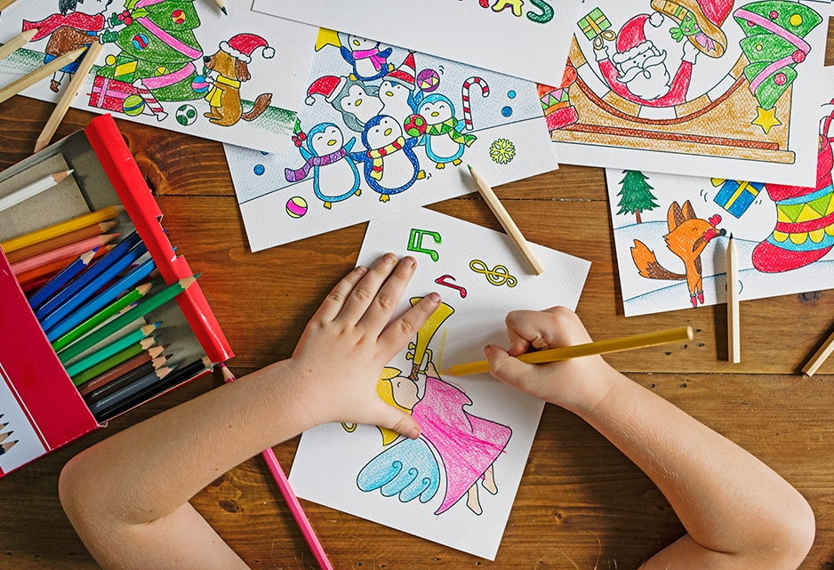
General Housekeeping

Slide 3
General Housekeeping
Email address: stmartin@st-bartholomewsrc-pri.kent.sch.uk
PE Day: Tuesday
Homework: Given on a Friday, due by following Wednesday
Spellings: Will sent home with homework on Fridays.
Uniform: Clearly labelled please.
Water bottles: Clearly labelled please.
Reading books: Changed on your child’s reading day, but requires a comment in the planner from yourselves so that we know that your child has read at home.
Planners: Children are to use these to help them to become more independent and to plan their days.
Lunches: Healthy lunchboxes please – no sweets or chocolates. A reminder that we are a nut free school.

Slide 4
Expectations

Slide 5
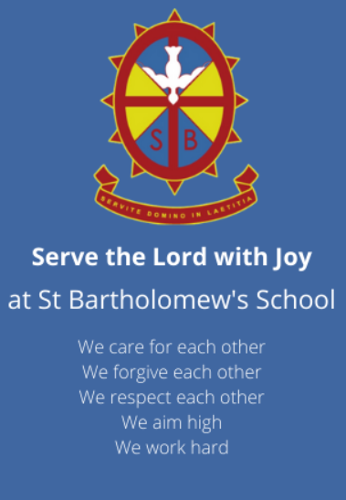
School Rules

Slide 6
Expectations
Behaviour
Uniform
PE Kits
Reading and spelling practice at home
Homework
Work hard, have fun!

Slide 7
Times Tables

Slide 8
Expectations
Times tables are incredibly important this year and a key focus in Lower Key Stage 2.
Year 4 will have their multiplication test. This is a government test.
Times Table Rockstar’s is available to support your child’s learning both in school and at home!

Slide 9
Websites

Slide 10
Websites
MyMaths
Purple Mash
TTRS
Ed Shed

Slide 11
Events and Trips

Slide 12
Events and Trips
This year, we have planned for lots of fun activities, linking with our curriculum areas, and have a few ideas for Summer term school trips.
Any trips will be planned well in advance and you will be notified.
We already have some exciting trips planned.

Slide 13
Thank You!
Any Questions?

