Slide 1
Welcome to
St. Andrew’s class
standrew@st-bartholomewsrc-pri.kent.sch.uk

Slide 2
About me
My name is Miss Evans
This is my third year at St Bartholomew’s and this will be my third year teaching Year 5 but my eighth year of teaching overall.
I started teaching after completing my Primary Education training at university and I have previously taught in Years 2, 3 and 4 in a school in Dartford.
I am very excited to teach this class and can’t wait to get to know the children and their families!

Slide 3
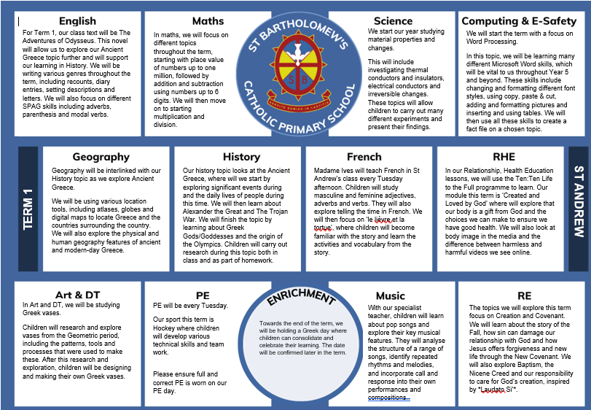

Slide 4
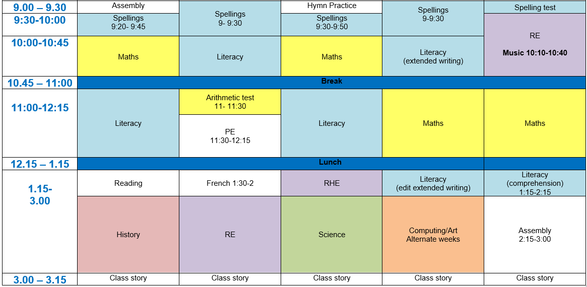

Slide 5
Homework
Homework will be set on a Friday and due in the following Wednesday (unless stated otherwise)
It will consist of three main pieces- literacy, maths and one other subject (RE, History, Geography etc.)
History/Geography/RE homework will often be used the following week in a lesson
The instructions for homework will be printed but are also available on the school website
Children will be given a paper folder at the beginning of the year to take their homework home. This folder does not need to be handed back in each week- children will place just their homework sheets into the homework box in the classroom.
Maths will predominantly be set on MyMaths
Spellings will also be set on a Friday and will be tested on the following Friday. A short activity will usually accompany the spellings- either printed or set on EdShed.

Slide 6
Homework
Please encourage children to read at home- they are more than welcome to take a book home from our class book corner, just please make sure it’s returned when finished.
As children are now free readers, they will not have a set reading day however I will endeavor to listen to each child regularly
Children completed their Multiplication Check in Year 4 last year however it is important for children to practice their timestables to ensure they can still rapidly recall these facts to aid them with Year 5 Maths. Please encourage the use of Times Tables Rock Stars at home.
All log ins were given at the start of the year.

Slide 7
Classroom ethos
I always try to foster a calm and positive classroom environment where children enjoy their time at school and feel comfortable to take risks and challenge themselves
I set these boundaries and expectations at the beginning of the year and as a class, we spend time practicing these routines and expectations. This will allow us to have a happy and successful year together
Children are rewarded for caring for and respecting each other, as well as working hard, aiming high and successfully completing their work
Children will receive house points for these values, as well as using our Good to be Green system to win a gold card or golden tickets
If a child isn’t showing the correct behaviours in school, we follow this structure:
  verbal warning
  blue warning card
  yellow warning card (miss break/part of lunch)
  red card (go to headteacher’s office and a call home)- this is only given serious or extreme situations

Slide 8
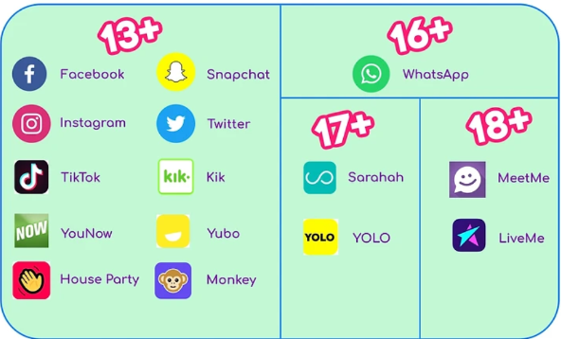
Social media and phones
Any issues outside of school on social media should be dealt with at home

Slide 9
Reminders
Children in Year 5 are allowed to walk home once written (email) confirmation
If a child walks home, they are allowed to bring in a mobile phone which is then locked away in class during the day
Please ensure all uniform is clearly labelled
Please ensure the correct royal blue PE kit is worn on PE days (Tuesday)
Small stud earrings are allowed but should be removed on PE day
Small, inexpensive watches are allowed (no smart watches)
No make up or nail varnish allowed
We are a nut free school so please make sure pack lunches are free from any nut or nut-containing products

Slide 10
Are there any questions?

Slide 11
Thank you!
Thank you very much for coming!
Please speak to me at the end of the day, email the class email or use the children’s planners if you need to let me know anything.
standrew@st-bartholomewsrc-pri.kent.sch.uk

