Slide 1

Welcome to
‘Meet the Teacher’ in St David’s class!
Your child’s teaching team this year are:
Mrs. Moran & Mrs. Marsh
stdavid@st-bartholomewsrc-pri.kent.sch.uk

Slide 2

A bit about us
This is my 12th year working as a teacher here at St Bart’s and my second in Year 6.
Prior to this year, I spent six years in St Theresa, Year 4. Before that, I was in St Paul’s class (Year 2/1) for two years and my initial teaching years were in St Clare (R/1) where I again spent two years.
Mrs Marsh joined me in three years ago, where we had many of you before in Year 4.

Slide 3
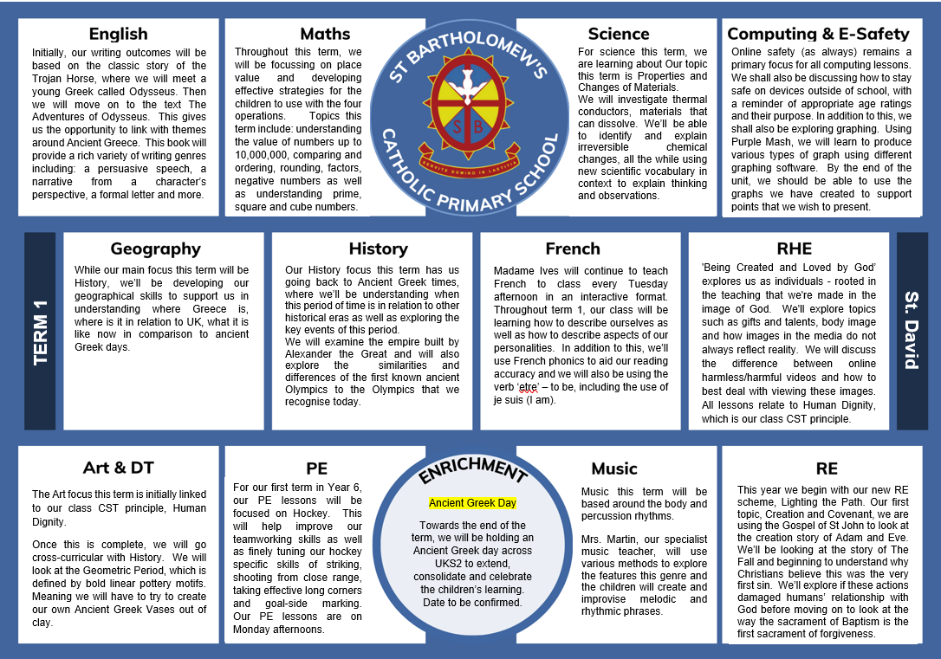
Plan for this term

Slide 4
Expectations
Your children are now the role models of the school, and as we all know, with great power comes great responsibility. By now we also know that ‘right is right even if no-one is doing it; wrong is wrong, even if everyone is doing it’.
Having previous experience of most of your children, I know they can be trusted to rise to this challenge - we might just need a few reminders along the way.
I have explained to the class that I expect them to participate fully in all that we do, both in class and in wider school life.

Slide 5

Reading
Reading is still super important! Children still should be reading daily at home as well as at school.

Slide 6
Times tables
Incredibly important still as the foundation of many core maths skills required in Year 6…
Division
Long multiplication
Algebra
Fractions
Decimals
Percentages
Ratio
Being fluent and able to access TT facts quickly, will help the children be successful in a vast number of other areas of maths!

Slide 7
Homework
Will be set weekly on a Friday and due back on Tuesday.
Homework this year, more than ever, will be incredibly important so I hope that I can count on your support with this.
Like last year, the homework will be posted on the website, with the children bringing home their task list.

Slide 8
Uniform
Please ensure all uniform is clearly labelled including PE kit
PE day is MONDAY and pupils are to continue to wear their kits to school
No jewellery (stud earrings are permitted),no nail varnish, no SMART watches
Uniform policy and lists can be found on our website for clarity
https://www.st-bartholomewsrc-pri.kent.sch.uk/School-Uniform/

Slide 9
General Reminders
Punctuality
Home time
Planners
Letters
Clubs
Mobile Phones

Slide 10
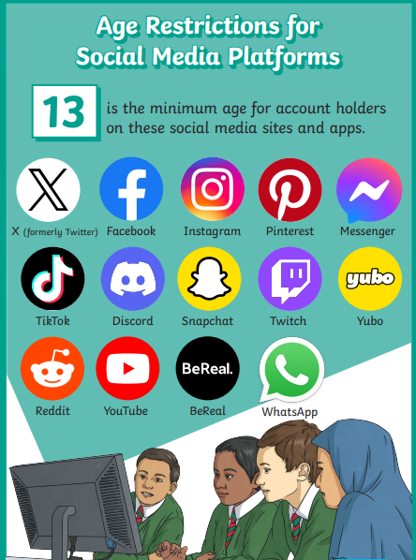
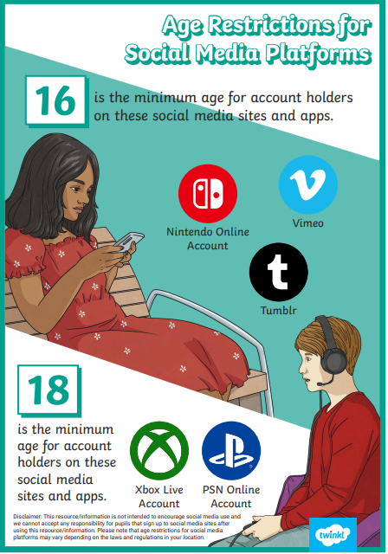
Online Safety
A reminder that the internet is not a particularly safe place for our children to be navigating alone.
Please know what your children are accessing (apps/social media etc.) and know what the age restrictions are for each one along with the capabilities that come hand in hand with each different application. Please also exercise the many parental controls that are available.

Slide 11
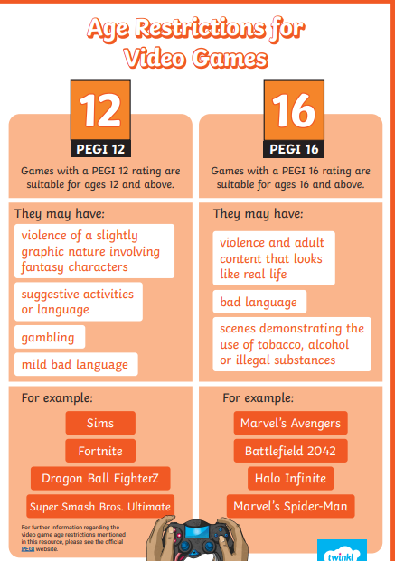
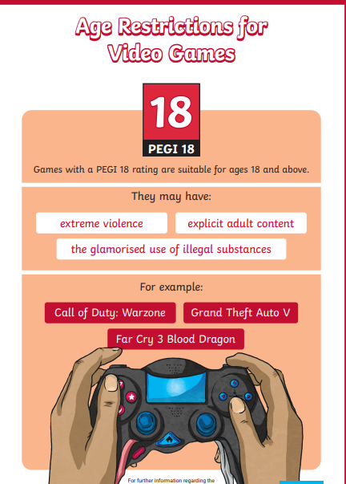
Online Safety

Slide 12
The Year Ahead
There will be lots of focussed learning but also lots of fun experiences for your children.
School trips & experience days
Christmas Carol Concert
Residential trip (more information and meetings to follow later in the year)
After school clubs
Buddy activities
Bake Off
End of Year production
End of Year disco
To list what I can think of currently think of, but there is so many great activities to off set…

Slide 13
The ‘S’ word…
I’m sure I don’t need to tell you what your children will face in May, but…
I can’t not mention it!
SATs
Firstly, I do not want you or your children to worry about these, the children will be well prepared by the time SATs week rolls around.
SATs week consists of 6 tests.
Monday 10th May – GPS
One 45 minute, 50 mark grammar and punctuation test, followed by a 15 minute, 20 mark spelling test.
Tuesday 11th May – English Reading
A 60 minute, 50 mark comprehension test
Wednesday 12th May – Maths
One 30 minute, 40 mark arithmetic paper, followed by a 40 minute, 35 mark reasoning paper
Thursday 13th – Maths
A 40 minute, 35 mark reasoning paper.

Slide 14
Any questions?

Slide 15

Thank you for coming and I look forward to working with your children again (for most of you) and getting to know your children, if I do not already.
Mrs Marsh & I are excited for the challenge of the year ahead!

