Slide 1
Meet the Teacher
St George’s Class
Monday 21st September

Slide 2
Staff working with St George’s class:
Mrs Hulls
Mrs Fenton
Mrs Sayers

Slide 3
Topics for the year
Autumn term | Spring term | Summer term
Marvellous Monarchs | Africa | Great fire of London
To embed the learning, each term will have a trip, experience or an enrichment activity planned

Slide 4
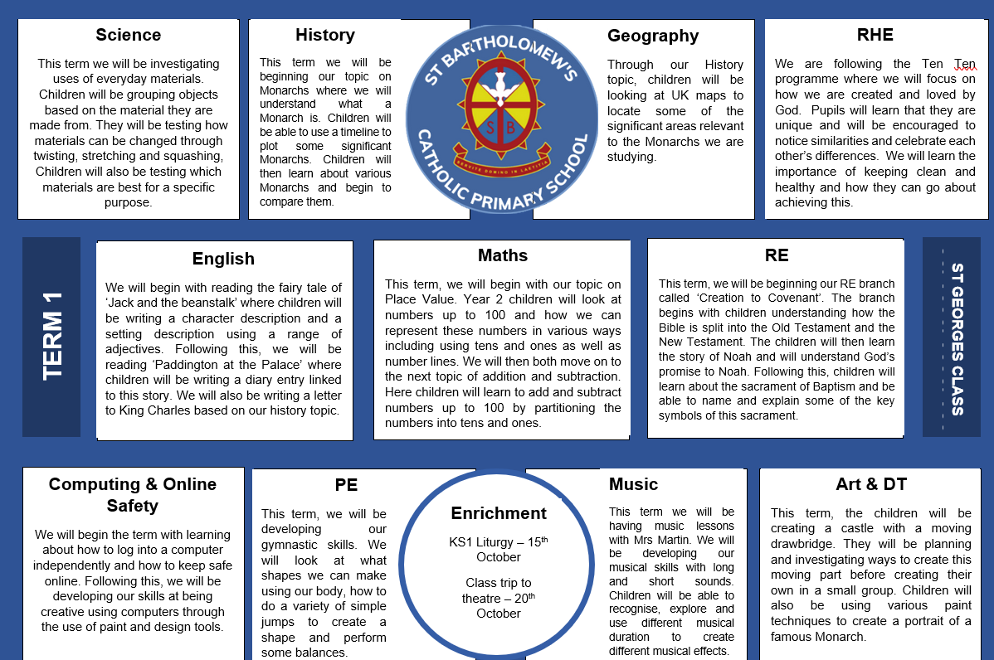
Overview for term

Slide 5






Some of the books that we will be covering this year

Slide 6
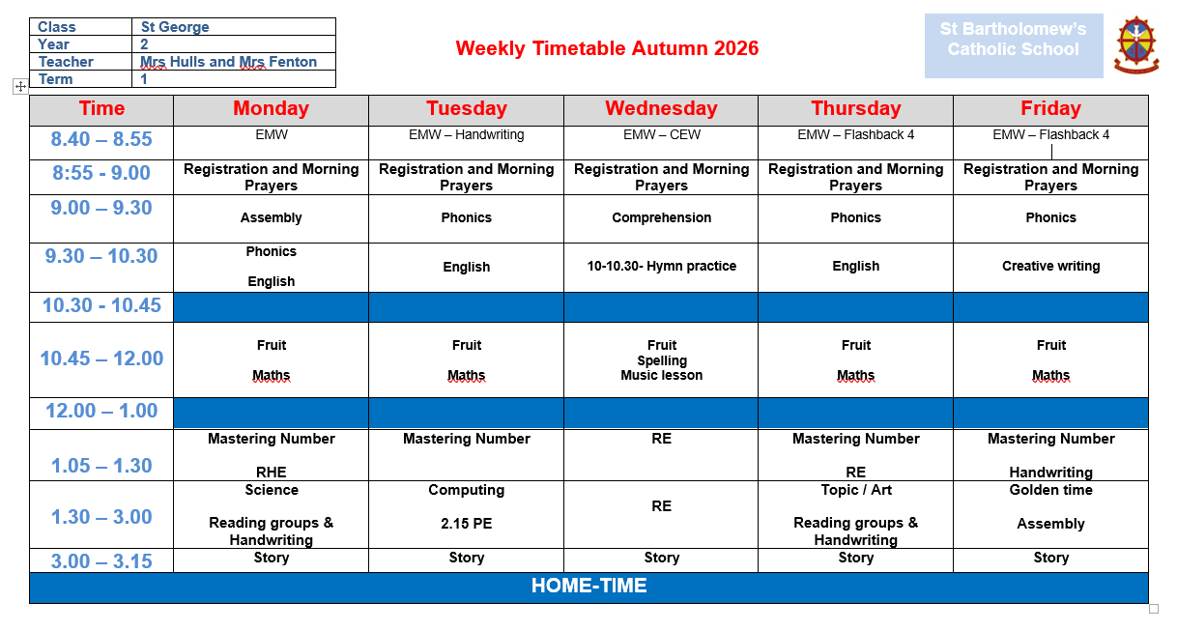
Weekly timetable

Slide 7

Reading at home
Reading at home is extremely important and will really help your child’s progress - at least 5-10 minutes each day.
Books are changed weekly and these are changed on their book changing day.
Please ensure there is a comment to let us know the book has been read.
Questioning about the book will really help to develop their understanding and comprehension skills. Book marks will be handed out next week to give you some ideas of questions.
We hear children read other books at school 2 times a week - these will not be noted in their reading records.
Notes:
NEED STAMINA FOR READING LONGER PIECES OF TEXTS

Slide 8

Phonics/Reading – continuing with Little Wandle
Daily phonics lessons following Little Wandle scheme taught in class. This will be for the autumn term only.
A group reading session with a member of staff 2 times a week.
Notes:
Examples of books

Slide 9
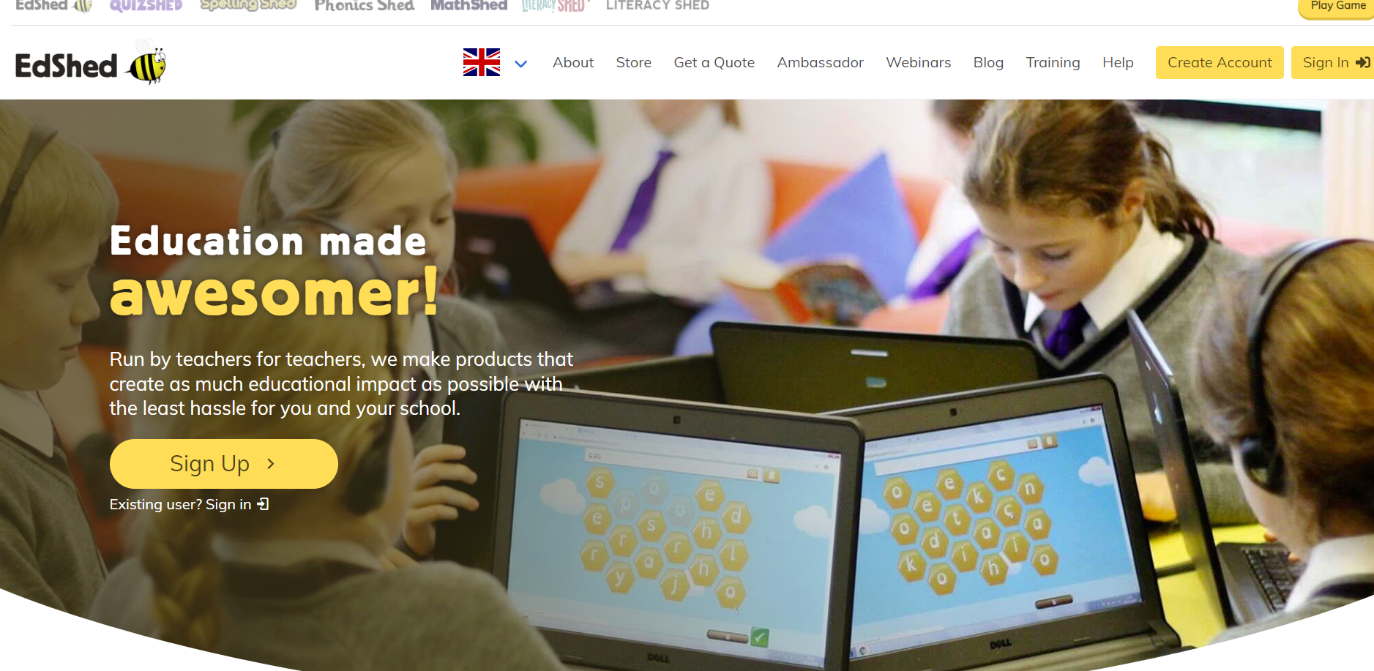
Spellings
Spelling programme will begin after Christmas.
Weekly practice on EdShed at home.
Notes:
Examples of books

Slide 10
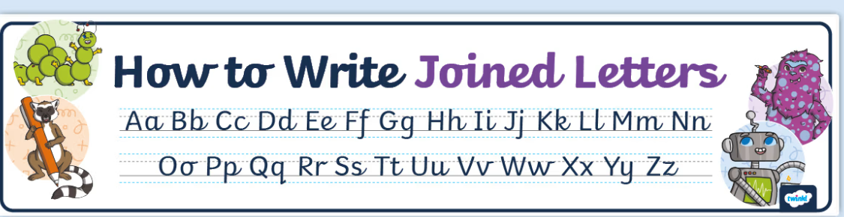
Handwriting

Slide 11
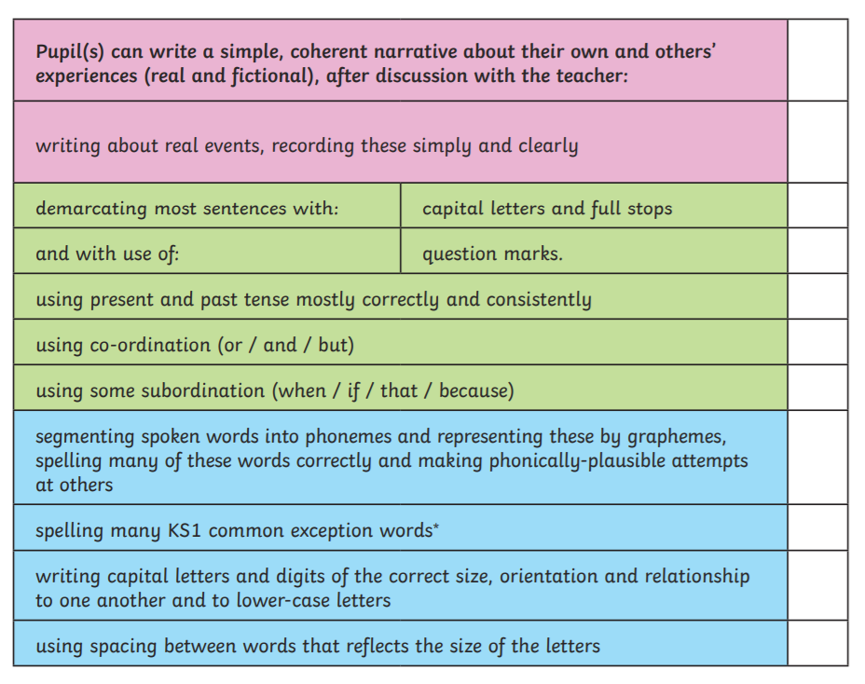
Writing
Checklist

Slide 12
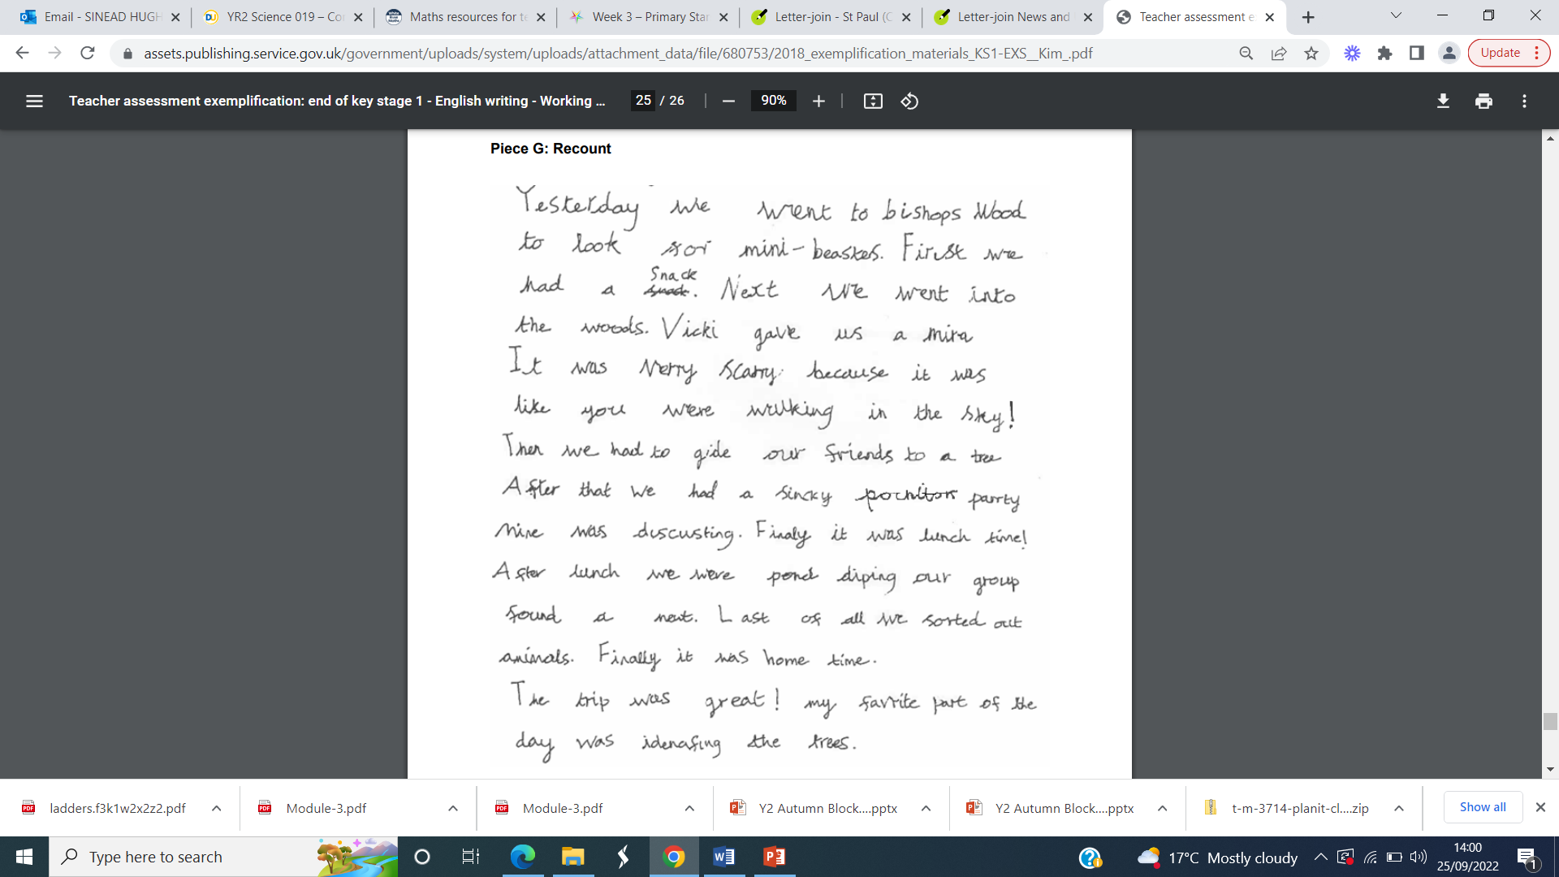
Year 2 expected piece of writing
Notes:
Is there an expected for year 1

Slide 13

Maths – key learning this year
Numbers up to 100 – forwards, backwards and partitioning
Number bonds to 20
Adding and subtracting 2 two-digit numbers
2, 5 and 10 times tables
Halves, quarters and thirds of shapes and numbers
Telling the time to the nearest 5 minutes
Adding coins and finding change
Measuring length, mass and capacity

Slide 14

Rewards
Good to be green
House points
Golden time
Wall of fame
Headteacher awards
Hot chocolate Fridays

Slide 15
Homework
Set on a Friday and due back in on the following Wednesday.
Homework includes a letter explaining homework for the week along with any notices.
One Maths and English piece of work every week.

Slide 16
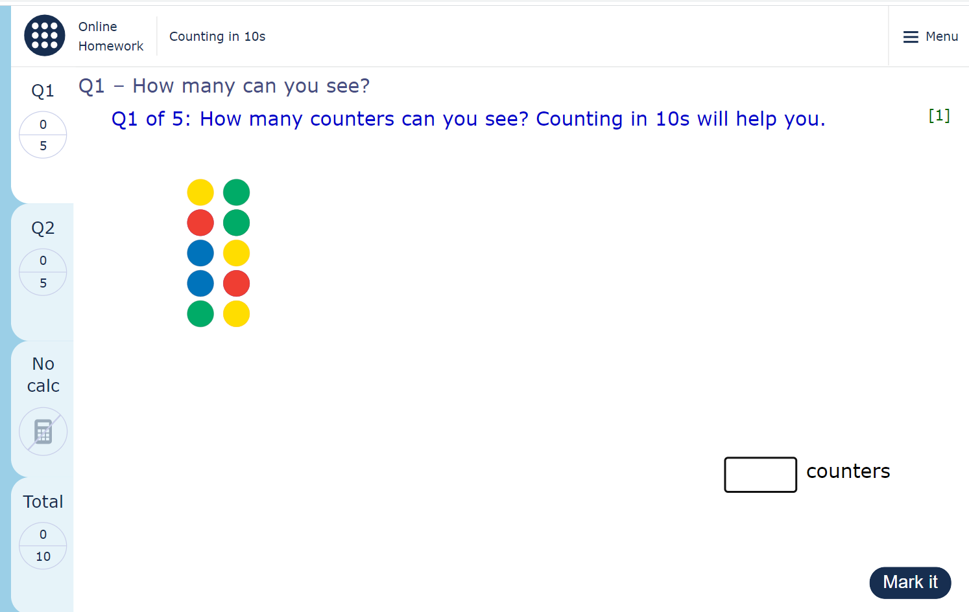
Homework - MyMaths

Slide 17
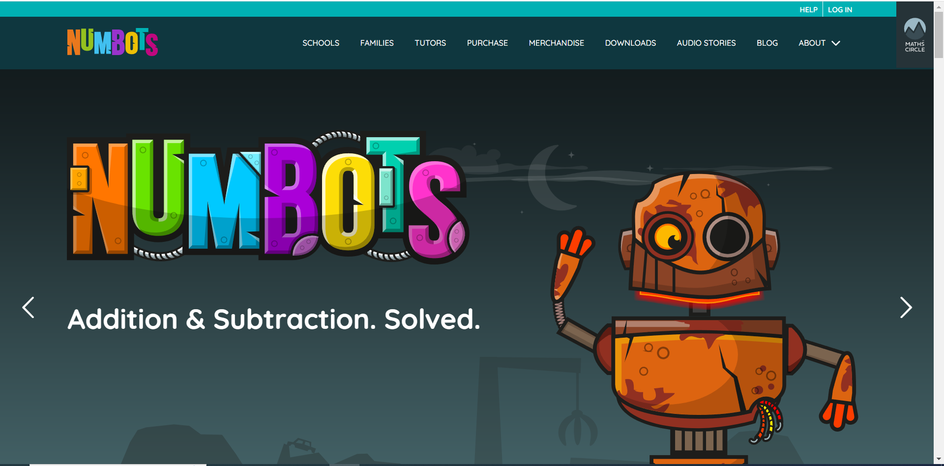
Other resources to support learning from home
* NumBots – fun maths game to support fluency in recalling facts.
All log in details are attached to reading records.

Slide 18

Other resources to support learning from home
* Times Tables Rock Stars.
All log in details are attached to reading records.

Slide 19
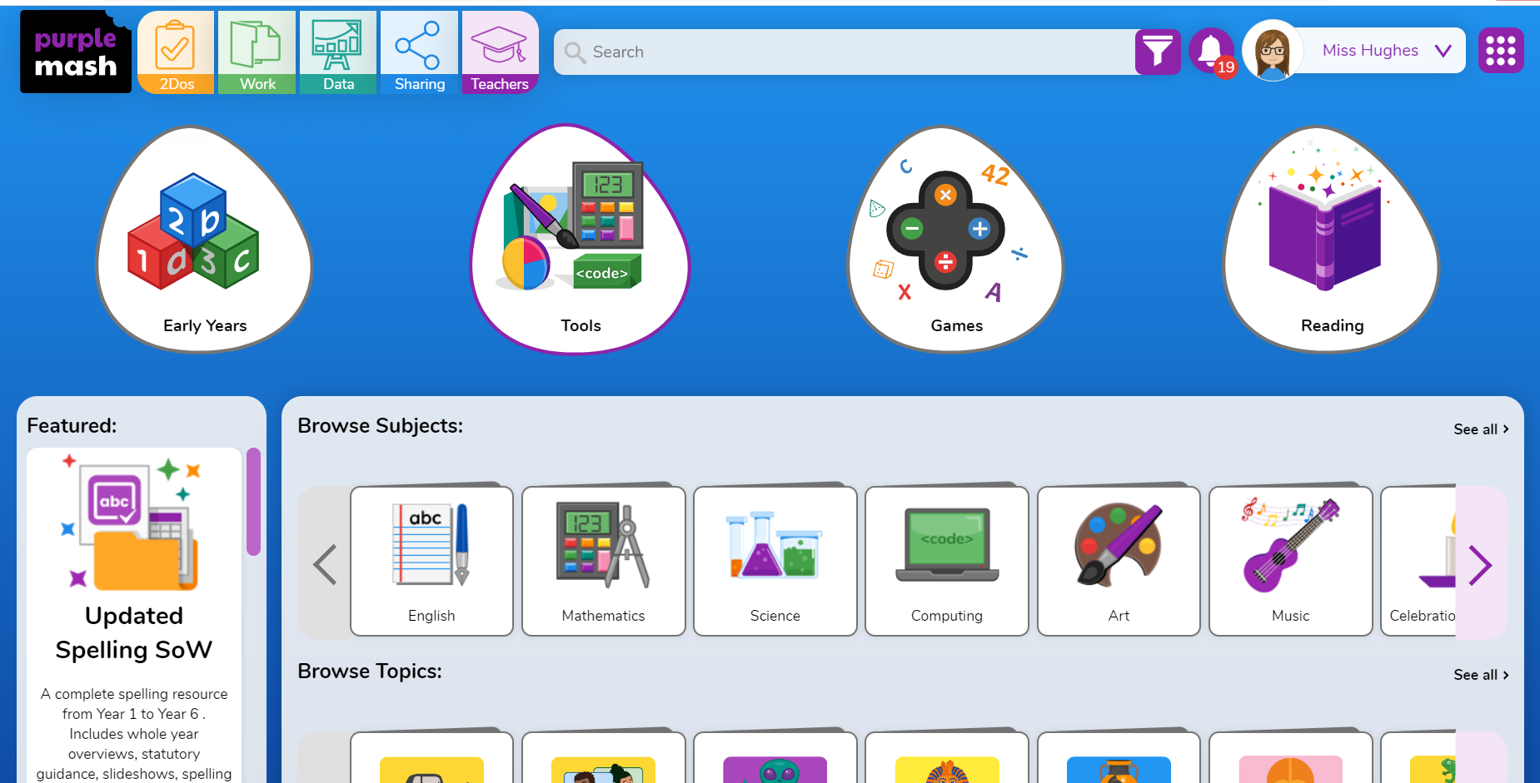
Other resources to support learning from home
* PurpleMash
All log in details are attached to reading records.

Slide 20
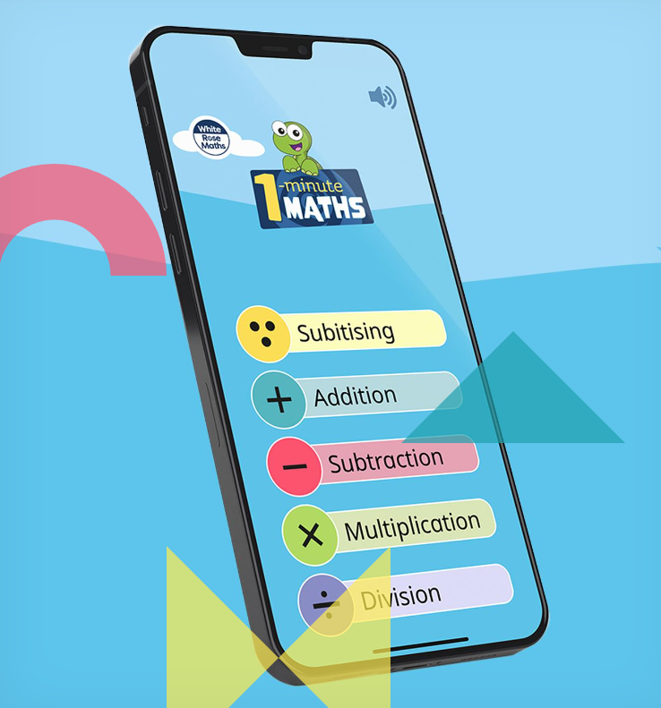
Other resources to support learning from home
* 1 minute maths app by White Rose
Notes:
TELLING TIME, MONEY, COUNTING, TIMES TABLES

Slide 21
General reminders
Please ensure all uniform is clearly named.
Water bottles should be brought in everyday.
PE on Tuesdays.
Please let us know if your child is being picked up by someone who does not usually pick up.
Happy to speak at the end of the day or you can use class email if you need to.
stgeorge@st-bartholomewsrc-pri.kent.sch.uk

Slide 22
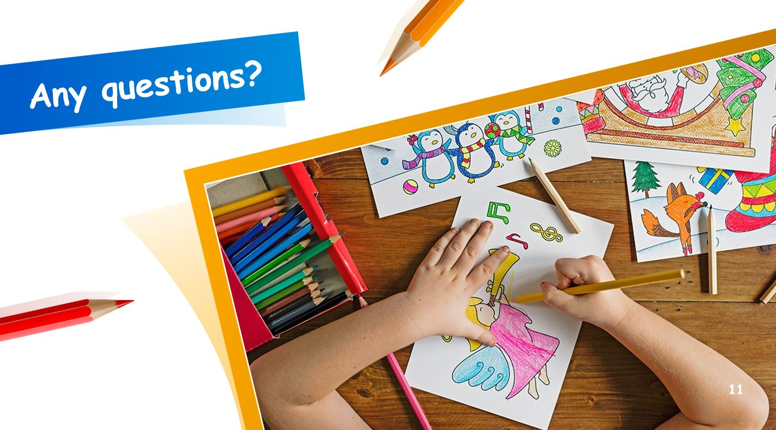
Any questions?

