Slide 1
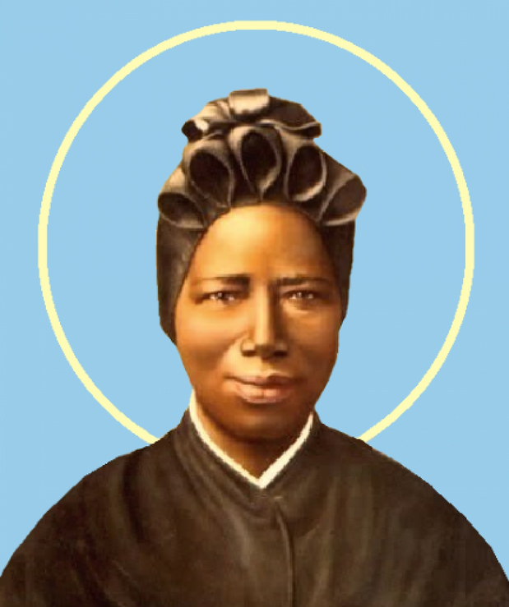
Welcome to St. Josephine’s Class
Year 3
Teacher: Miss Carter
Teaching Assistant: Mrs Sullivan and Mrs Sayers
Email: stjosephine@st-bartholomewsrc-pri.kent.sch.uk

Slide 2

Transition Information
Your child is now in Key Stage 2 - Lower Key Stage 2 (Year 3 & 4)
- Upper Key Stage 2 (Year 5 & 6)
The academic transition from Year 2 to Year 3 is substantial, please don’t be alarmed!
Your child can now choose to bring a packed lunch.
Your child will now be able to attend swimming lessons (after Easter).
Yellow reading journals have been replaced by the school planner.
We encourage the children to care of their own property in Year 3 to promote independence.

Slide 3

Reminders
Every day, please can your child wear/bring in the following:
School jumper/cardigan
Waterproof coat with a hood
Shoes (not trainers)
Filled water bottle
Piece of fruit for breaktime (optional)
School bag (reading book and planner)
PE is on Monday and as you are already aware children are to come into school wearing their PE kit.
Full PE kit: Royal blue shorts, a white T-shirt with no logos, trainers/plimsolls and a royal blue tracksuit. A pair of white socks are useful when girls start to wear tights in winter.
This is a NUT FREE school

Slide 4

READING
Frequent and supervised reading is immensely important as it enhances literacy skills, boosts vocabulary, improves comprehension, fosters a love for reading and supports academic success. Regular reading also encourages imagination and critical thinking.
Please read regularly with your child at home and sign off their reading in their planner.
Your child’s book will be changed on a weekly basis once they have been read and signed off by an adult.
A bookmark with useful questions to help boost your child’s comprehension skills will be sent home shortly.
Reading stages are not solely changed due to the amount of books your child has read. Reading stages are assessed on your child’s inference skills, understanding of what has been read and their ability to summarise the text, decode more challenging vocabulary, their expression and their reading pace.

Slide 5
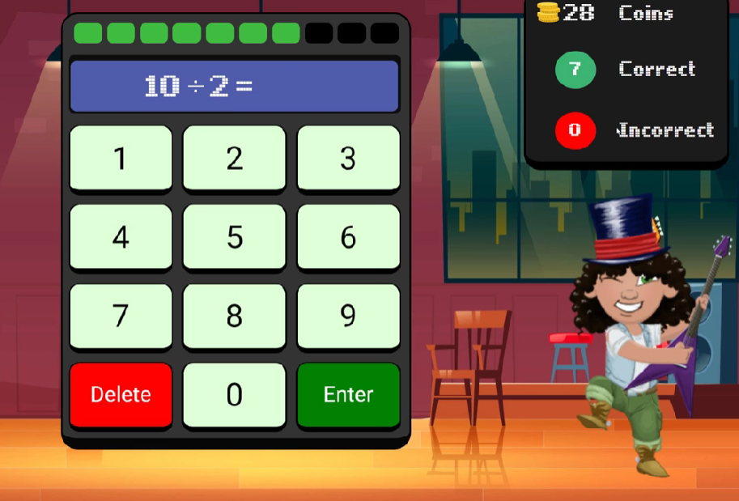

TIMES TABLES
In Year 3 there is a firm focus on the children learning their Times Tables with a particular focus on the 2s, 5s, and 10s at the beginning of the year. Once mastered, we will then progress onto the 3s, 4s and 8s. This will prepare the children well for the Year 4 Multiplication Tables Check next year.
Times Tables Rock Stars (TTRS) is very helpful to practise their Times Tables and related division facts. TTRS share similarities to the Multiplication Tables Check layout. Please ensure they play as frequently as possible.

Slide 6

WEEKLY HOMEWORK
(Either set to consolidate the week’s learning or to give prior knowledge)
Set on a Friday and to be returned by the following Wednesday.
It will usually consist of an English task and a Maths task
The homework tasks set may be either a hard copy or online via My Maths, Purple Mash or Spelling Shed.
Your child’s login details for Times Tables Rock Stars, Purple Mash, My Maths and Spelling Shed are attached inside the back cover of their school planner.
The expectation is that by Key Stage 2, your child will be able to log on independently to Times Tables Rock Stars, My Maths, Purple Mash and Spelling Shed. Please assist them initially but do encourage them to become more independent as the year progresses!

Slide 7
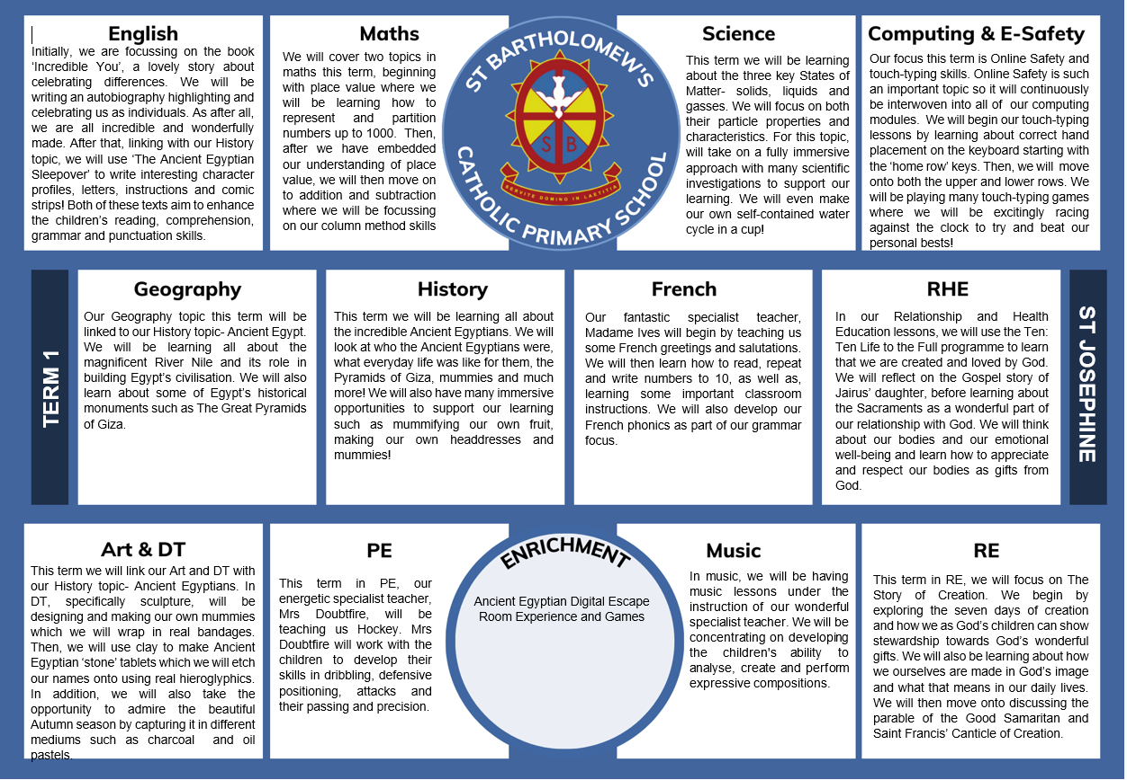

Slide 8
Communication
Please feel free to speak to me about any questions or concerns that you may have. The best time for this is immediately after school when most of the children in the class have been dismissed.
Alternatively, if you just want to let me know about an appointment or a change of adult collecting, a note can be written in your child’s planner or you can notify the school office.
Unfortunately, I wont be able to inform you of every minor mishap, however, if a situation needs to be discussed I will ask to speak with you.
For non-urgent matters, there is a class email address:
stjosephine@st-bartholomewsrc-pri.kent.sch.uk

Slide 9

Thank you for coming this evening.
We are looking forward to a great year!

