Slide 1
Meet the Teacher
St Paul’s Class
Monday 21st September

Slide 2
Staff working with St Paul’s class:
Mrs Hitchcock– Class Teacher
Mrs Sharp – Teaching Assistant

Slide 3
Topics for the year
Autumn term | Spring term | Summer term
Monarchs | Into the wild - Africa | London’s Burning
To embed the learning, each term will have a trip, experience or an enrichment activity planned

Slide 4

Overview for term

Slide 5









Some of the books that we will be covering this year

Slide 6
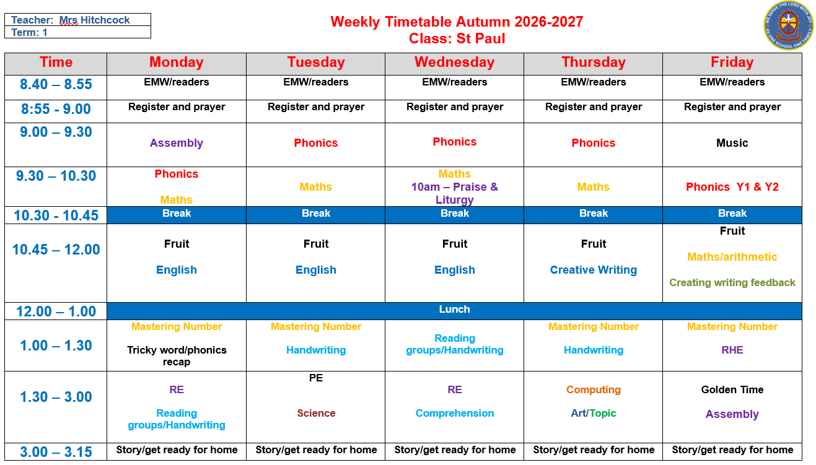
Weekly timetable
Notes:
Mention how this will work with mixed aged classes.
Separate phonics sessions – year 1 / year 2
Maths – covering both objectives
English – work together but outcomes of year 1 children are different to year 2
Year 1 play at break and lunch with year 1 children from the other classes
Topics may be slightly different so trips may be slightly different between classes
Importance of being in on time

Slide 7

Reading at home
Reading at home is extremely important and will really help your child’s progress - at least 5-10 minutes each day.
Books are changed weekly – their book changing day will be on a sticker on the front of their reading record book.
Please ensure there is a comment to let us know the books have been read – this is how we know that their books need changing.
Questioning about the book will really help to develop their understanding and comprehension skills.
We hear children read other books at school 3x a week so these will not be noted in their reading records.

Slide 8

Phonics/Reading –Little Wandle
Daily phonics lessons following Little Wandle Letters and Sounds – taught in class.
New sounds each day.
No spelling tests for year 1.
Year 2 will have spellings, starting with common exception words
A group reading session with a member of staff 3 times a week. Books are new and follow the programme.
Notes:
Examples of books

Slide 9

Phonics – year 1 and year 2
Year 1s phonics screening check will happen in June.
Phonics meeting later in the year with more details.
Reading at home as much as possible will really support your child with this.

Slide 10
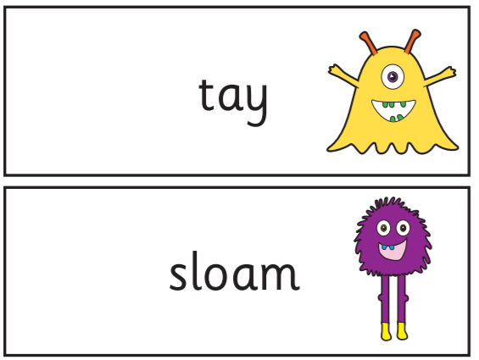
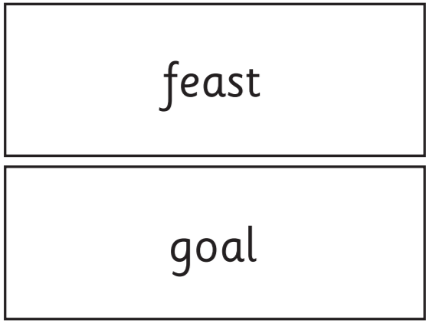
40 questions to answer

Slide 11
SATs – year 2 only
SATs are no longer statutory for children in year 2.
We do however use the papers as our teacher assessment, in replacement of different assessments.

Slide 12
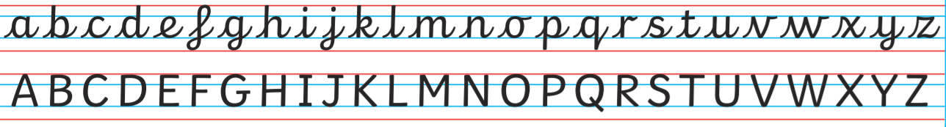
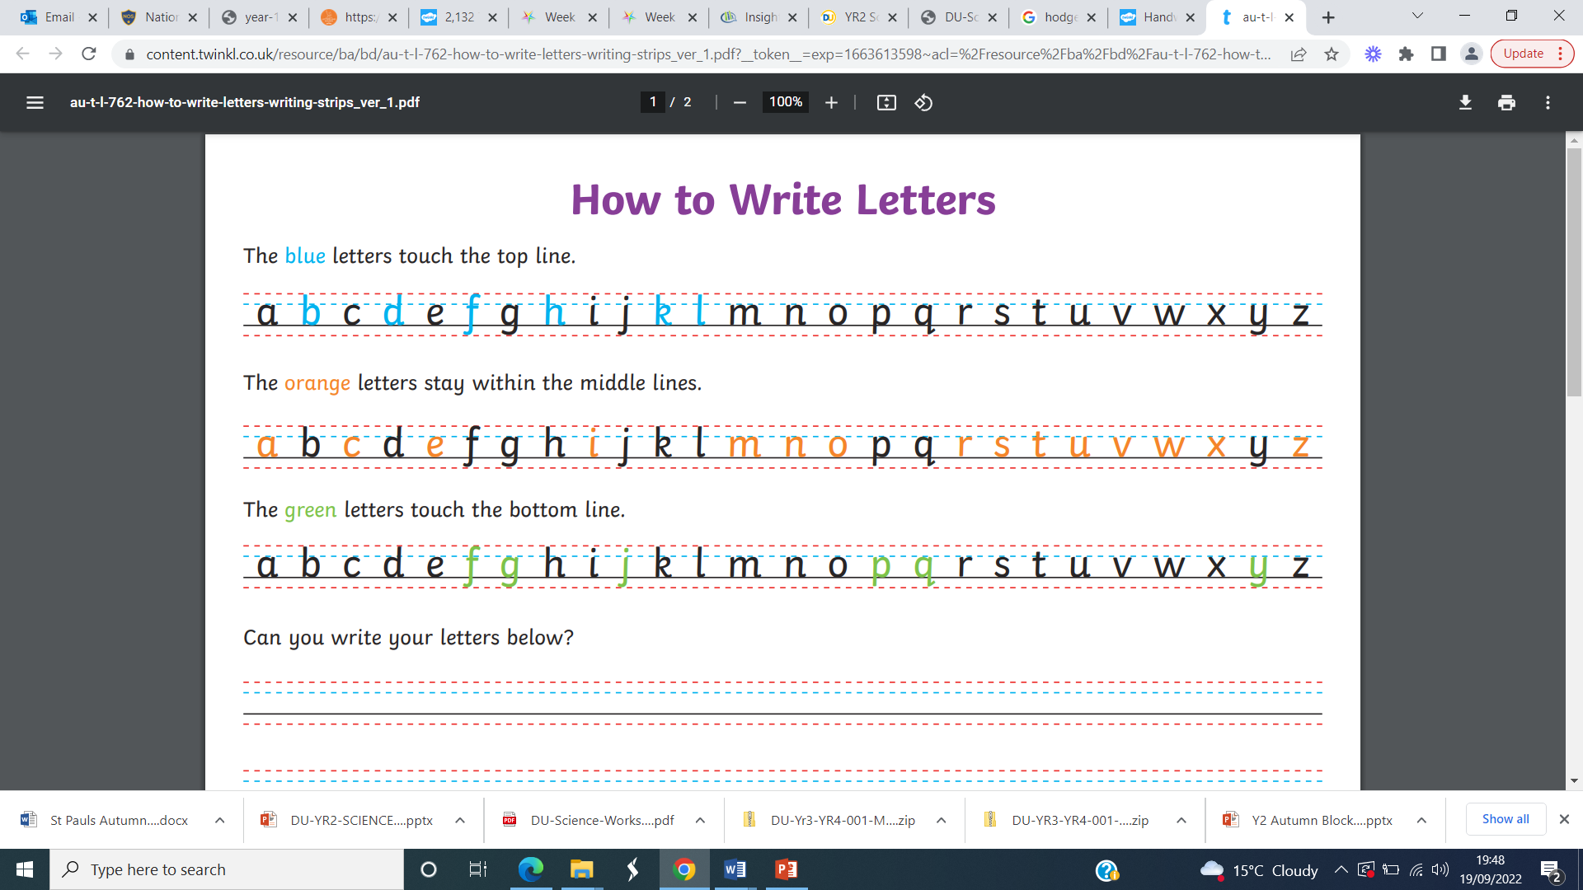
Handwriting – cursive style (year 2)
Handwriting – print style (year 1)

Slide 13
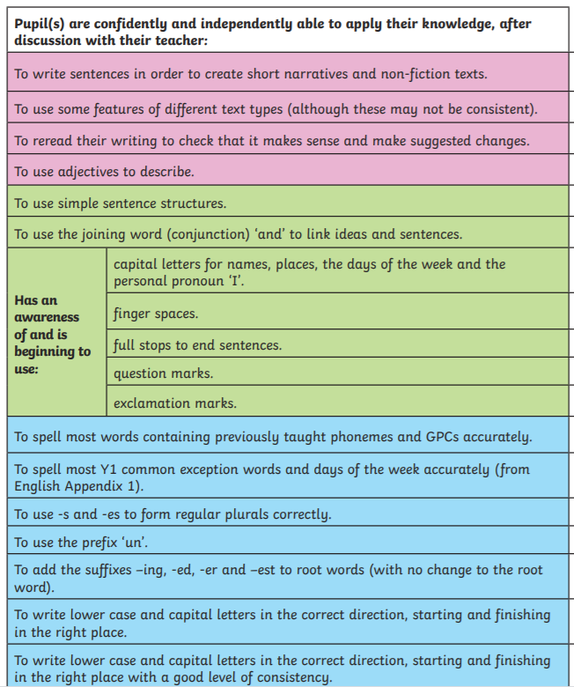
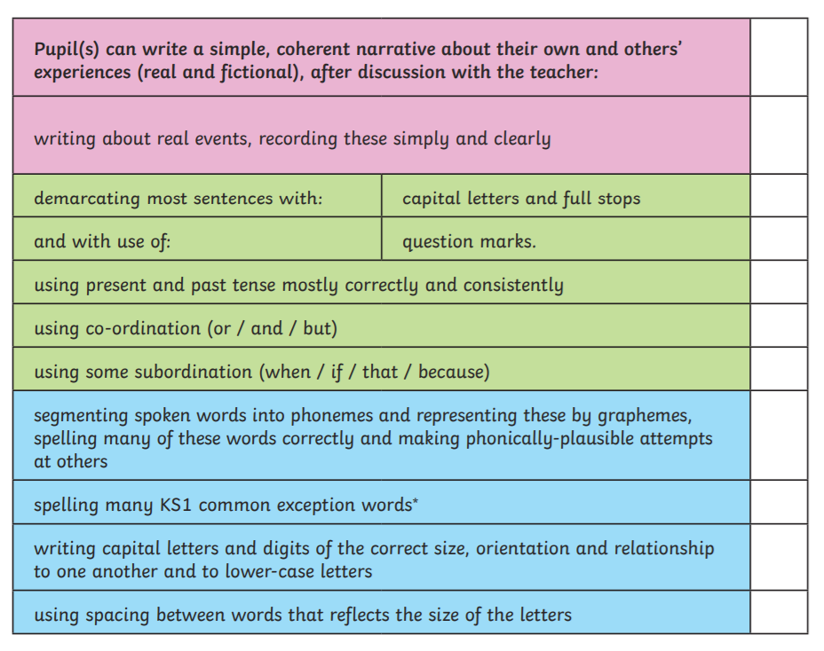
Writing checklist – year 1
Writing checklist – year 2

Slide 14

Rewards
* Good to be green
* House points
* Headteacher award
* Golden time
* Star of the day/week

Slide 15
Homework
Set on a Friday and due back in on the following Wednesday.
Homework folder includes a letter explaining homework for the week along with any notices.
One Maths and English piece of work every week.
Spellings for year 2

Slide 16
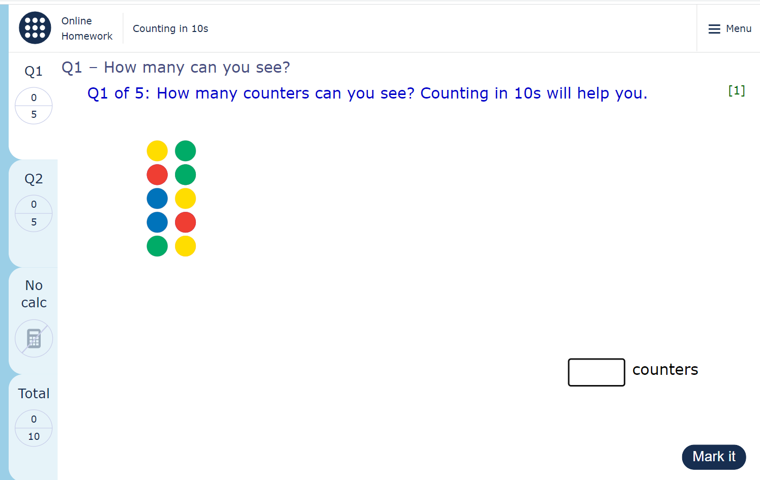
Homework - MyMaths

Slide 17
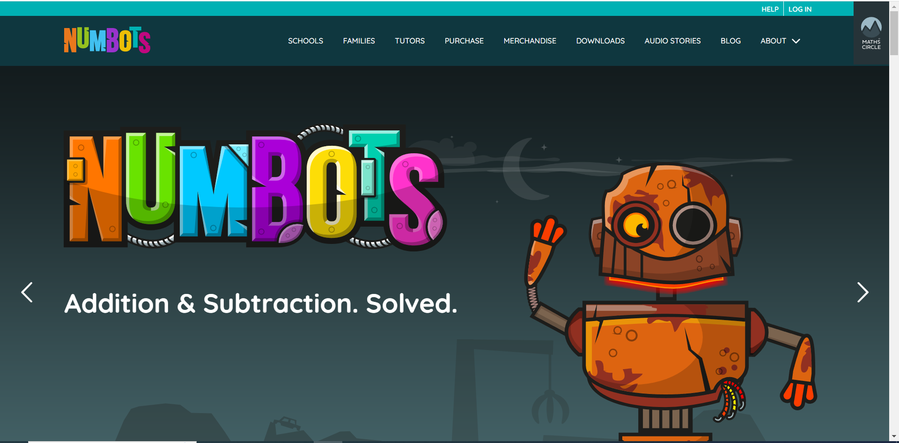
Other resources to support learning from home
* NumBots – fun maths game to support fluency in recalling facts.
All log in details are attached to reading records.

Slide 18

Other resources to support learning from home
* Times Tables Rock Stars – recommended for year 2 and above.
All log in details are attached to reading records.

Slide 19
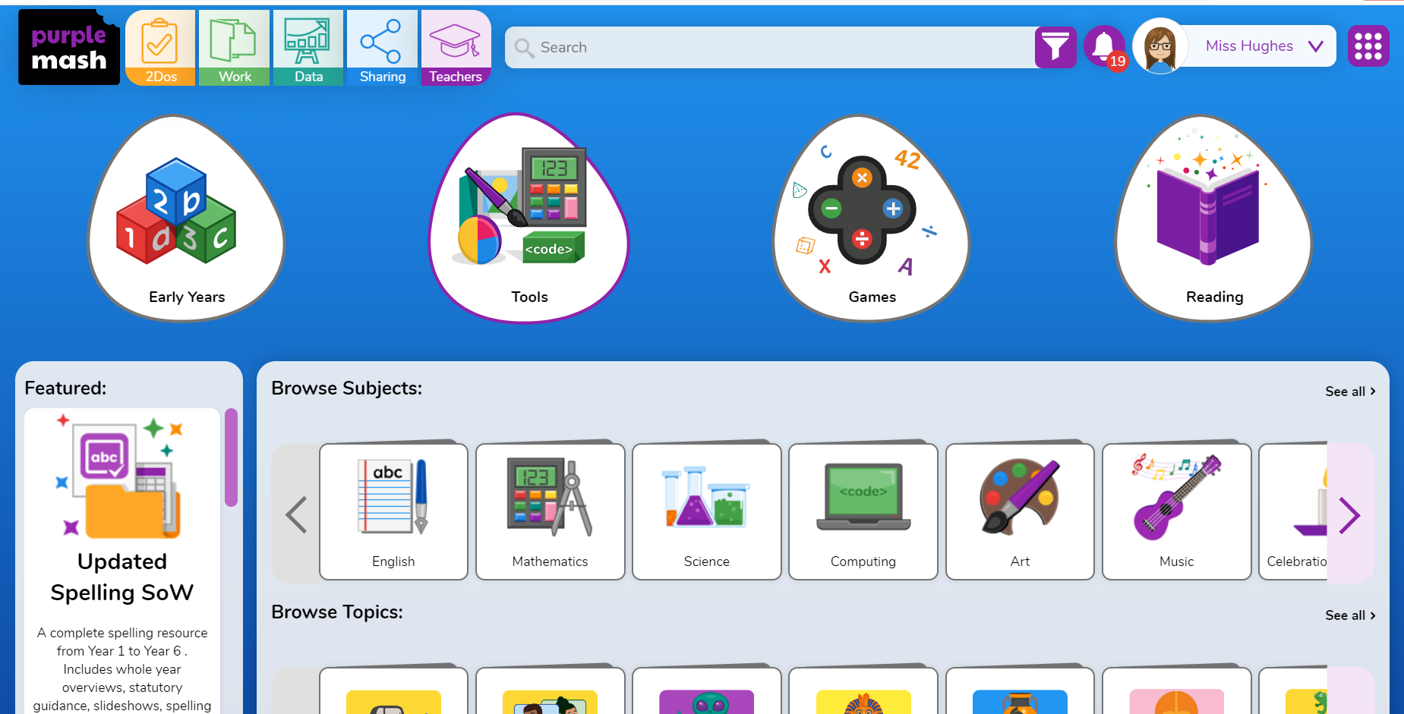
Other resources to support learning from home
* PurpleMash
All log in details are attached to reading records.

Slide 20
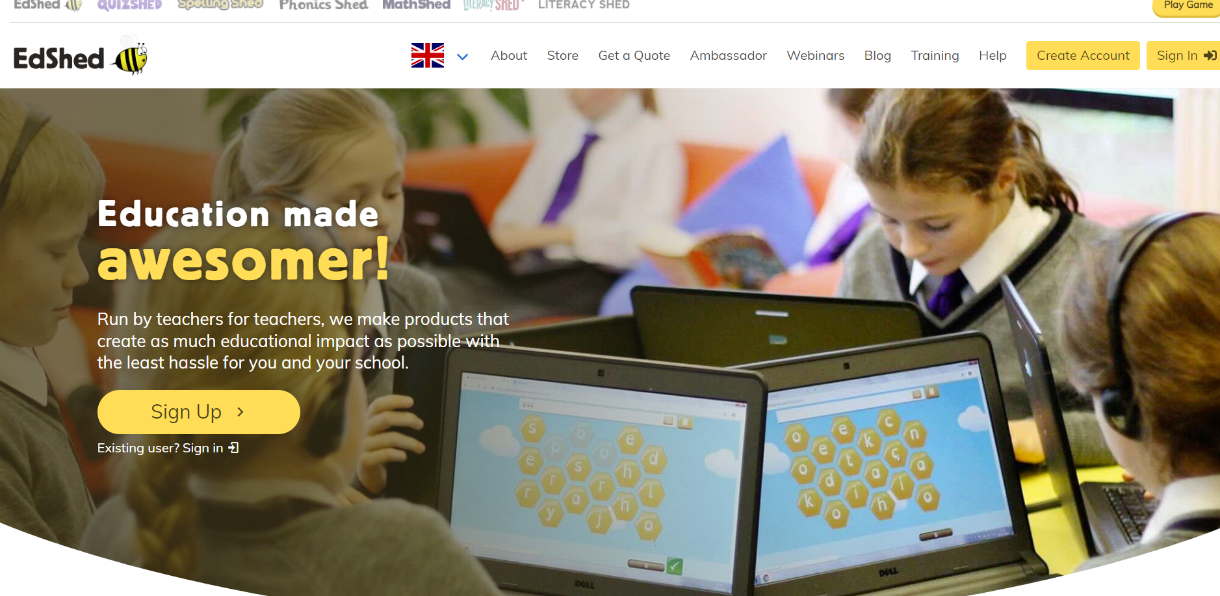
Other resources to support learning from home
* EdShed
All log in details are attached to reading records.

Slide 21
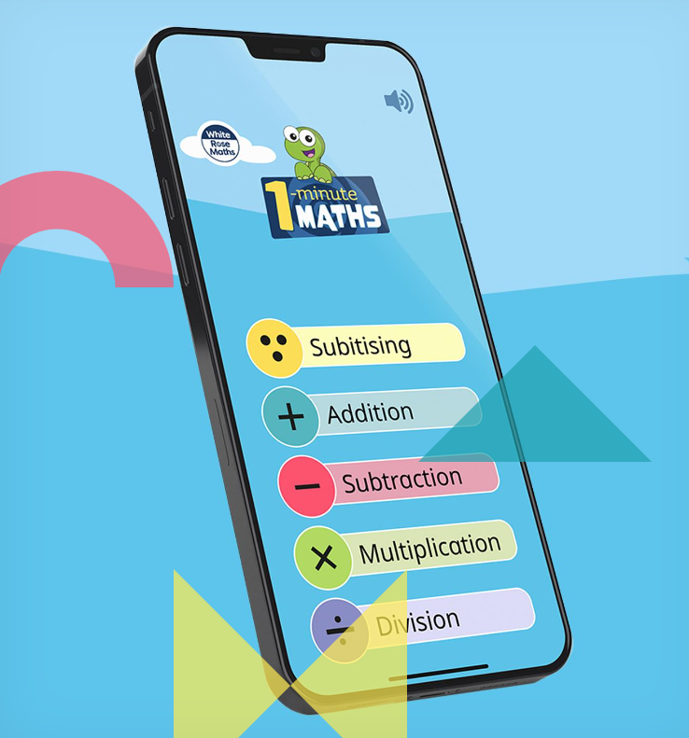
Other resources to support learning from home
* 1 minute maths app by White Rose

Slide 22
General reminders
Please ensure all uniform is clearly named.
Water bottles should be brought in everyday.
PE on Tuesdays – PE kit to be worn into school.
Please let us know if your child is being picked up by someone who does not usually pick up.
Happy to speak at dismissal or you can use class email if you need to.
stpaul@st-bartholomewsrc-pri.kent.sch.uk

Slide 23
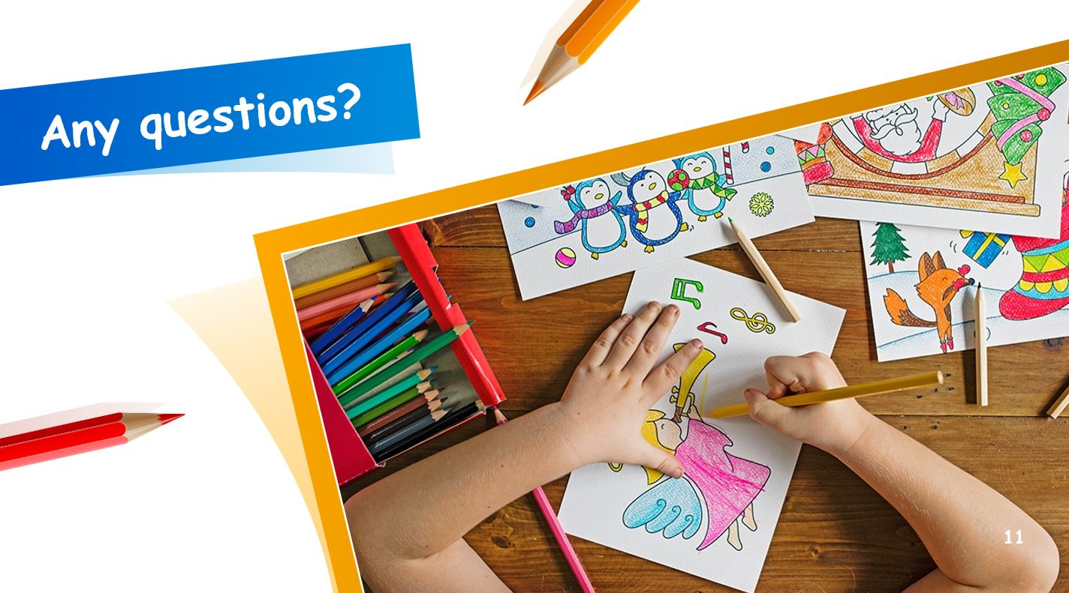
Any questions?
Thank you for coming!

