Slide 1
Meet the Teacher
St Peter’s Class
Monday 21st September 2026

Slide 2
Staff working with St Peter’s class:
* Mrs Kaszycka – class teacher
* Mrs Medhurst- teaching assistant

Slide 3
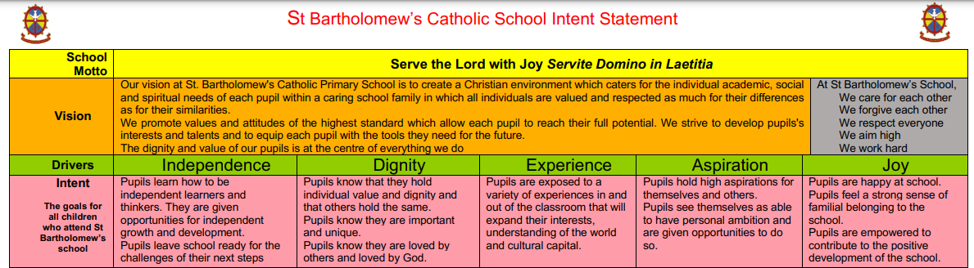

Slide 4
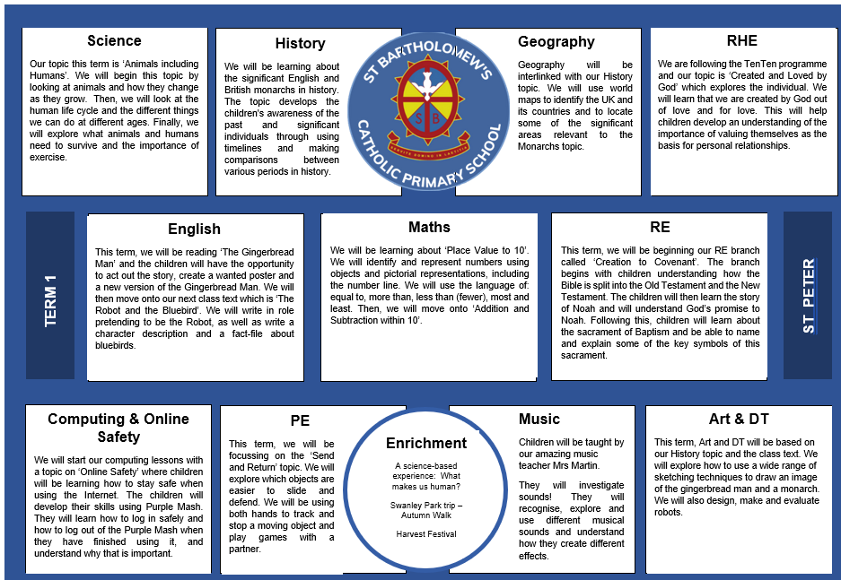

Slide 5
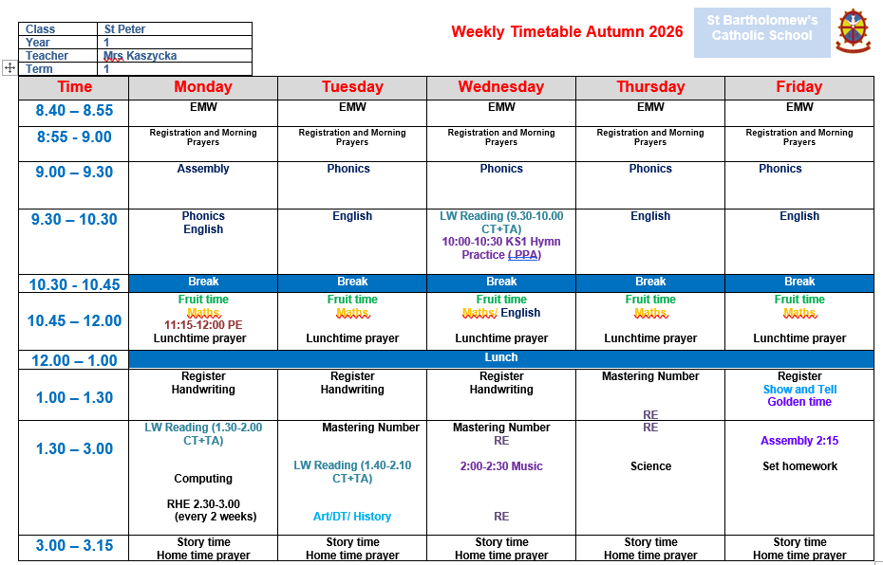
Weekly timetable

Slide 6









Some of the books that we will be covering this year

Slide 7
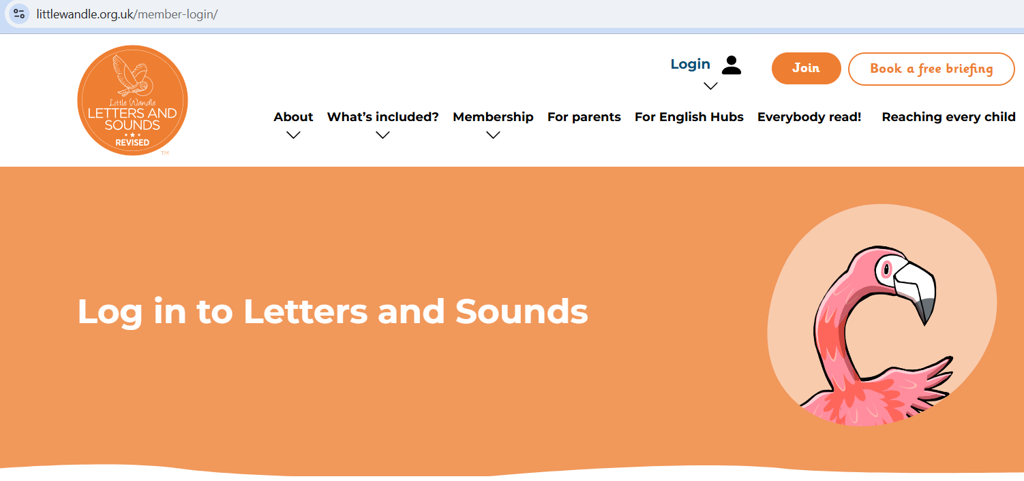
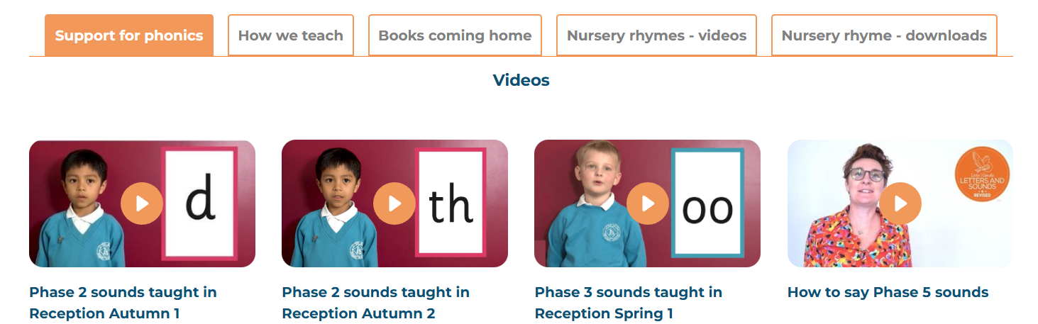
Phonics
St Bartholomew’s has chosen Little Wandle Letters and Sounds Revised as our systematic, synthetic phonics (SSP) programme to teach early reading and spelling.
Daily, whole class phonics lessons.
Daily interventions.

Slide 8
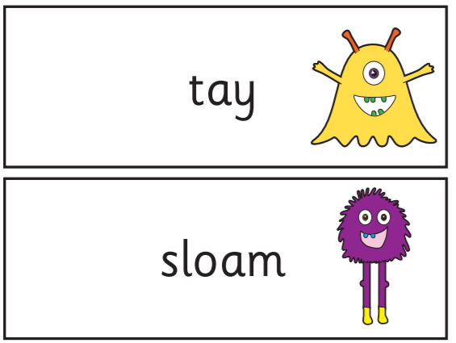
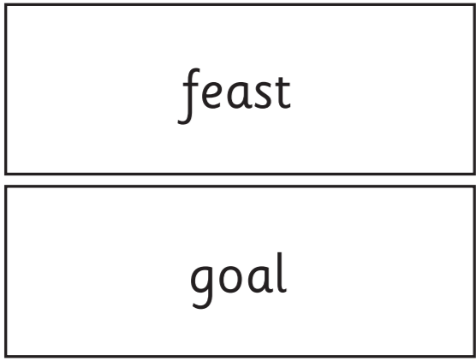
All Year 1 children undertake Phonics Screening in June 2027.
Meeting about the Phonics Screening will be at the beginning of Term 3.
40 questions to answer

Slide 9
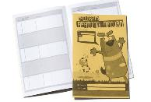
Reading at home
Reading at home is extremely important and will really help your child. Please read with your child at least 10-15 minutes each day. Questioning about the book will help to develop their understanding and comprehension skills. Reading directly impacts on writing and quality of vocabulary used.
Children’s books will be changed once a week. Children have been allocated a changing day – they need to bring their books in on that day. If the books are not handed in they will not be changed as we have very little time to change them through the week.
Please ensure there is a comment to let us know the books have been read. We will not be reading this book with your child in school. We hear children read other books at school 3x a week and these will not be noted in their reading records.

Slide 10

Reading at school
We use assessment to match your child the right level of book.
A group reading session with a member of staff is 3 times a week. Books follow the programme ‘Little Wandle’.

Slide 11
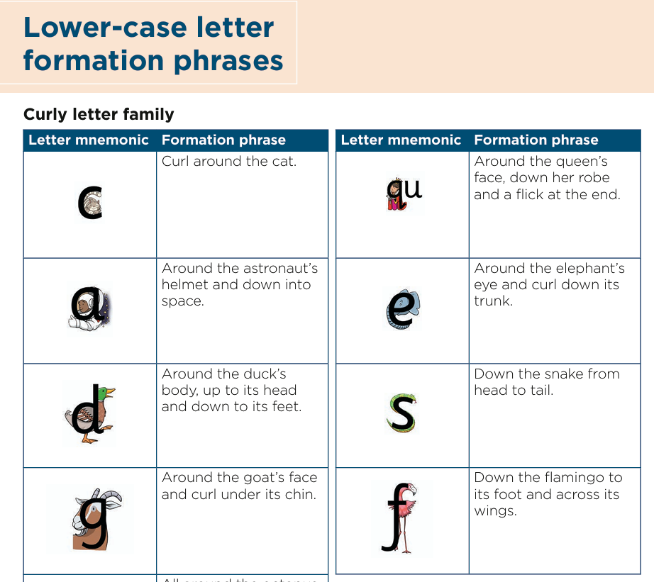
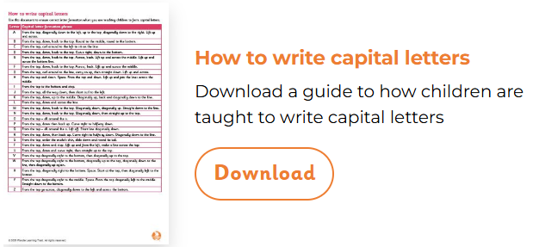
Handwriting – (year 1)

Slide 12

Rewards
* Verbal praise from teacher, another adult, head or deputy head
* Good to be Green
* Hot Chocolate Friday
* CST cup
* House points
* Headteacher award
* Stickers
* Table Points
* Golden time

Slide 13
Homework
* Set on a Friday and due back in on the following Wednesday.
* Homework includes a letter explaining homework tasks along with any notices.
* Maths and English piece of work every week.
On occasions, a cross-curricular focus may also be set.
* Homework needs to be their independent work.

Slide 14

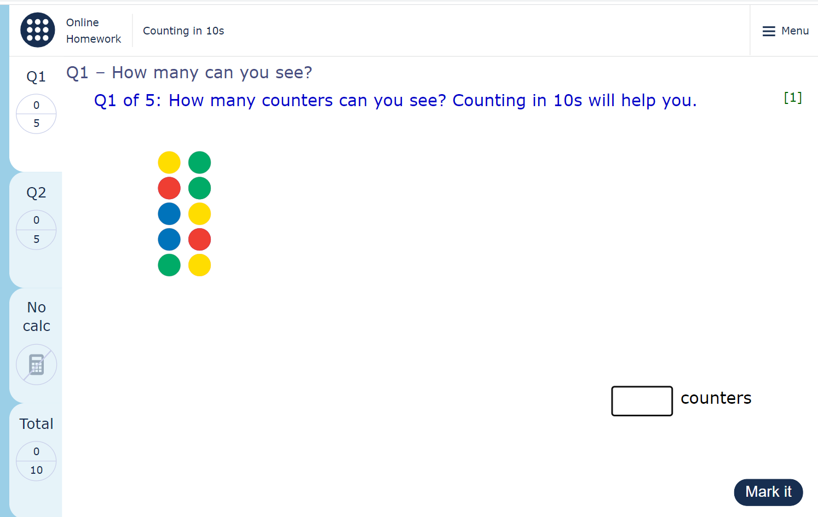

Maths Homework
Maths tasks will be often set online via:
MyMaths or NumBots – fun maths games to support fluency in recalling facts
LOG IN DETAILS WILL BE ATTACHED TO CHILDREN’S READING RECORDS BOOKS.

Slide 15
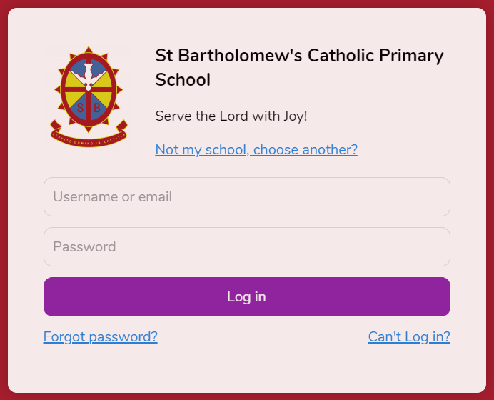
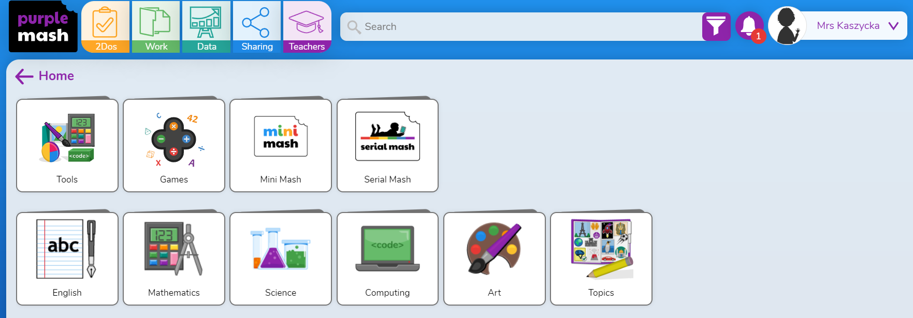
Other resources to support learning from home
* Purple Mash
LOG IN DETAILS WILL BE ATTACHED TO READING RECORDS BOOKS.

Slide 16
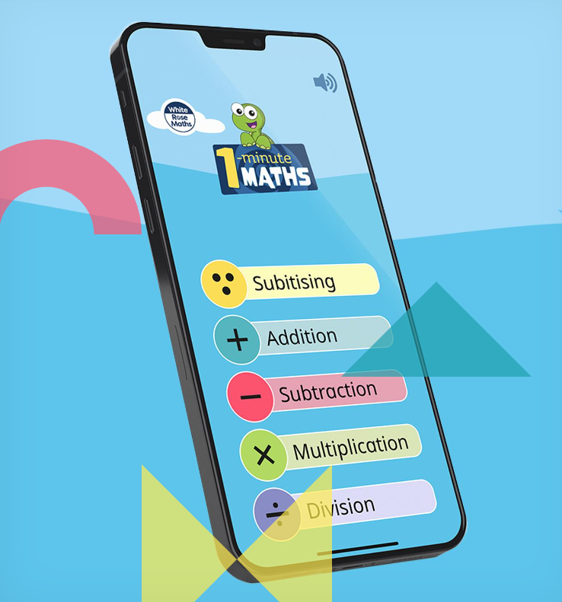
Other resources to support learning from home
* 1 minute maths app by White Rose

Slide 17
General reminders
* Please ensure all uniform is clearly named.
Name tapes are particularly useful as handwritten names rub off in the wash.
*A reusable water bottle should be named and brought into school daily for your child. Please ensure that it contains only water not juice or other drinks.
* Please let us know if your child is being picked up by someone who does not usually pick up.

Slide 18
PE
PE lessons take place on Mondays with a PE coach and class teacher.
Children to come into school on Mondays in their PE kits.
Earrings – Please ensure that you are only wearing small studs to school if you have your ears pierced. Make sure your earrings are taped up or taken out ready for your PE days.

Slide 19
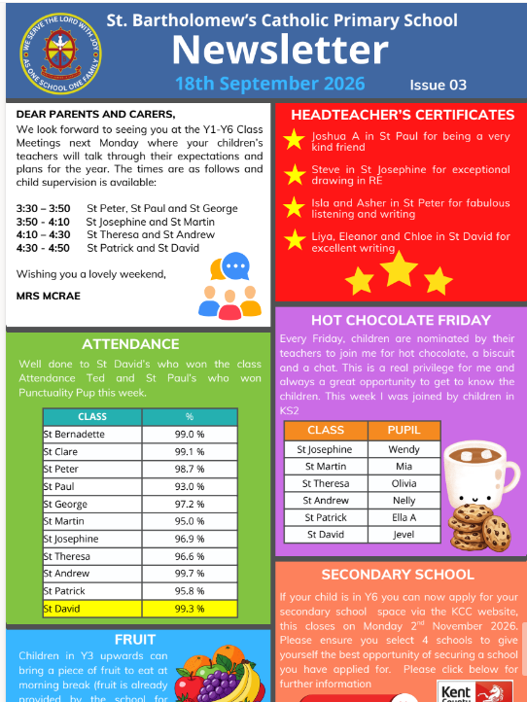
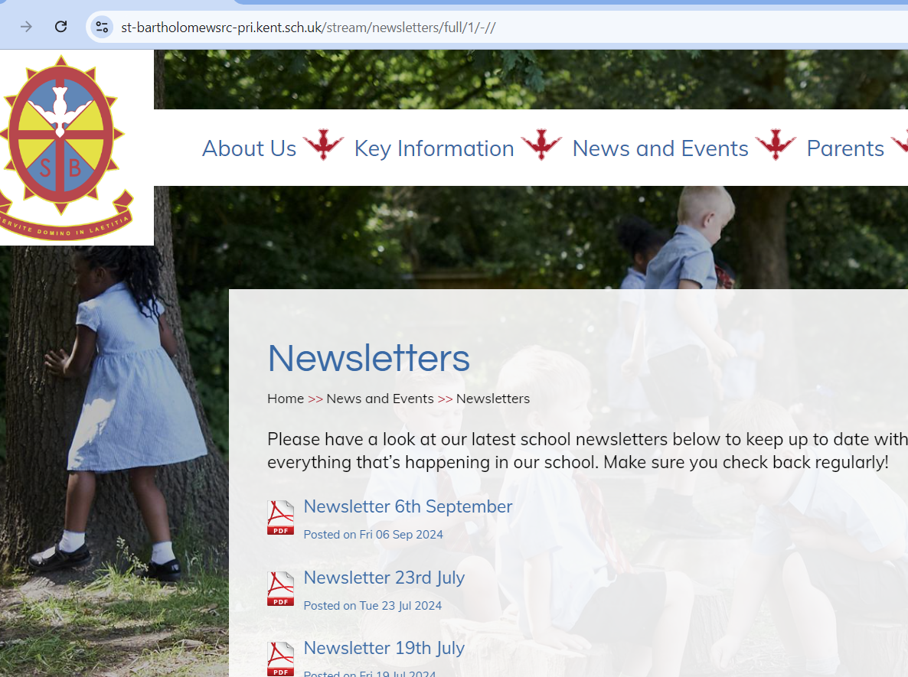
School website
https://www.st-bartholomewsrc-pri.kent.sch.uk/

Slide 20
Communication
Please feel free to speak to me about any questions or concerns that you may have.
The best time for this is immediately after school when most of the children in the class have been dismissed.
Alternatively, there is a class email address which I will endeavour to check regularly:
stpeter@st-bartholomewsrc-pri.kent.sch.uk

Slide 21
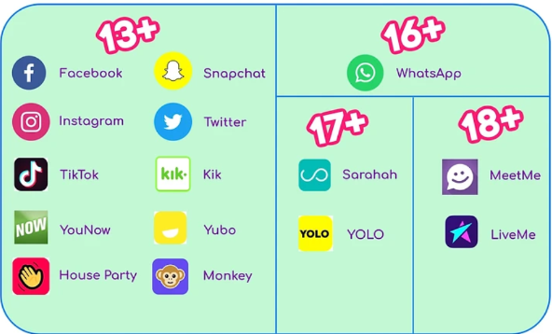
Online Safety

Slide 22
Thank you for coming and listening

